Slide 1
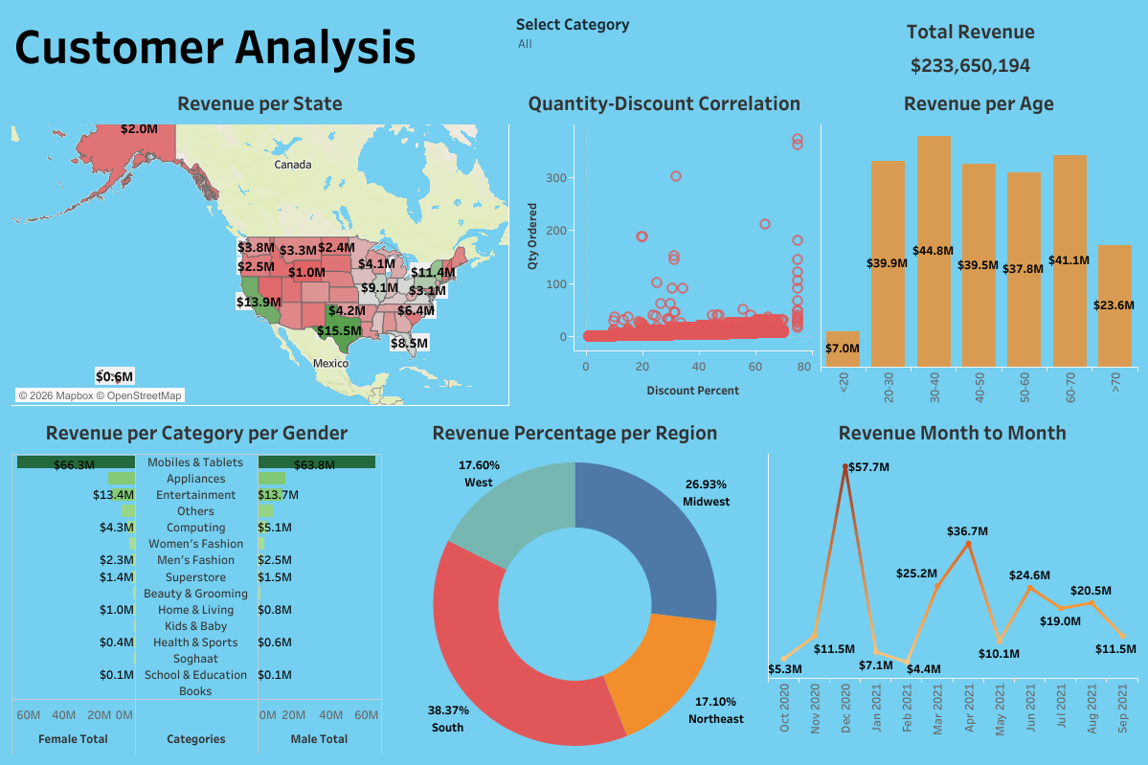
4
04
03
02
01
Dashboard
Project structure
This project contains a data file, the Tableau file, and this PowerPoint presentation.
Dashboard techniques
In this Dashboard you will find standard cards like a Map, Bar Chart, Scatter plot, as well as more complex cards like Donut chart and a Butterfly bar chart.
Dashboard requirements
Display revenue per state
Display revenue based on month of the year
Display revenue based on age
Graph Quantity/Discount percent correlation
Show percentage of revenue per region
Show revenue per category per gender
3
Customer
Analysis
2
1

Slide 2
4
04
03
02
01
Dashboard
Project structure
This project contains a data file, the Tableau file, and this PowerPoint presentation.
Dashboard techniques
In this Dashboard you will find standard cards like a Map, Bar Chart, Scatter plot, as well as more complex cards like Donut chart and a Butterfly bar chart.
Dashboard requirements
Display revenue per state
Display revenue based on month of the year
Display revenue based on age
Graph Quantity/Discount percent correlation
Show percentage of revenue per region
Show revenue per category per gender
3
Customer
Analysis
2
1

Slide 3
4
04
03
02
01
Dashboard
Project structure
This project contains a data file, the Tableau file, and this PowerPoint presentation.
Dashboard techniques
In this Dashboard you will find standard cards like a Map, Bar Chart, Scatter plot, as well as more complex cards like Donut chart and a Butterfly bar chart.
Dashboard requirements
Display revenue per state
Display revenue based on month of the year
Display revenue based on age
Graph Quantity/Discount percent correlation
Show percentage of revenue per region
Show revenue per category per gender
3
Customer
Analysis
2
1

Slide 4
4
04
03
02
01
Dashboard
Project structure
This project contains a data file, the Tableau file, and this PowerPoint presentation.
Dashboard techniques
In this Dashboard you will find standard cards like a Map, Bar Chart, Scatter plot, as well as more complex cards like Donut chart and a Butterfly bar chart.
Dashboard requirements
Display revenue per state
Display revenue based on month of the year
Display revenue based on age
Graph Quantity/Discount percent correlation
Show percentage of revenue per region
Show revenue per category per gender
3
Customer
Analysis
2
1

Slide 5
4
04
03
02
01
Dashboard
Project structure
This project contains a data file, the Tableau file, and this PowerPoint presentation.
Dashboard techniques
In this Dashboard you will find standard cards like a Map, Bar Chart, Scatter plot, as well as more complex cards like Donut chart and a Butterfly bar chart.
Dashboard requirements
Display revenue per state
Display revenue based on month of the year
Display revenue based on age
Graph Quantity/Discount percent correlation
Show percentage of revenue per region
Show revenue per category per gender
3
Customer
Analysis
2
1

Slide 6
01
Dashboard requirements
Display revenue per state
Display revenue based on month of the year
Display revenue based on age
Graph Quantity/Discount percent correlation
Show percentage of revenue per region
Show revenue per category per gender
1

Slide 7
02
Dashboard techniques
In this Dashboard you will find standard cards like a Map, Bar Chart, Scatter plot, as well as more complex cards like Donut chart and a Butterfly bar chart.
2

Slide 8
03
Project structure
This project contains a data file, the Tableau file, and this PowerPoint presentation.
3

Slide 9
4
04
Dashboard

